Slide 1
Year 11 GCSE Information Evening

Slide 2
GCSE exams are different this year
GCSE qualifications will be assessed via exams and non examination assessments as normal.
However adaptations will be made to each qualification
These adaptations vary depending on the qualification
Adaptations may include removal of units, reduction of content, reduction of aspects of the non examined unit.
We will teach in line with these adaptations.
A booklet containing all adaptations for GCSE can be found by following this link to the WJEC website.
https://www.wjec.co.uk/home/2022-everything-you-need-to-know/

Slide 3
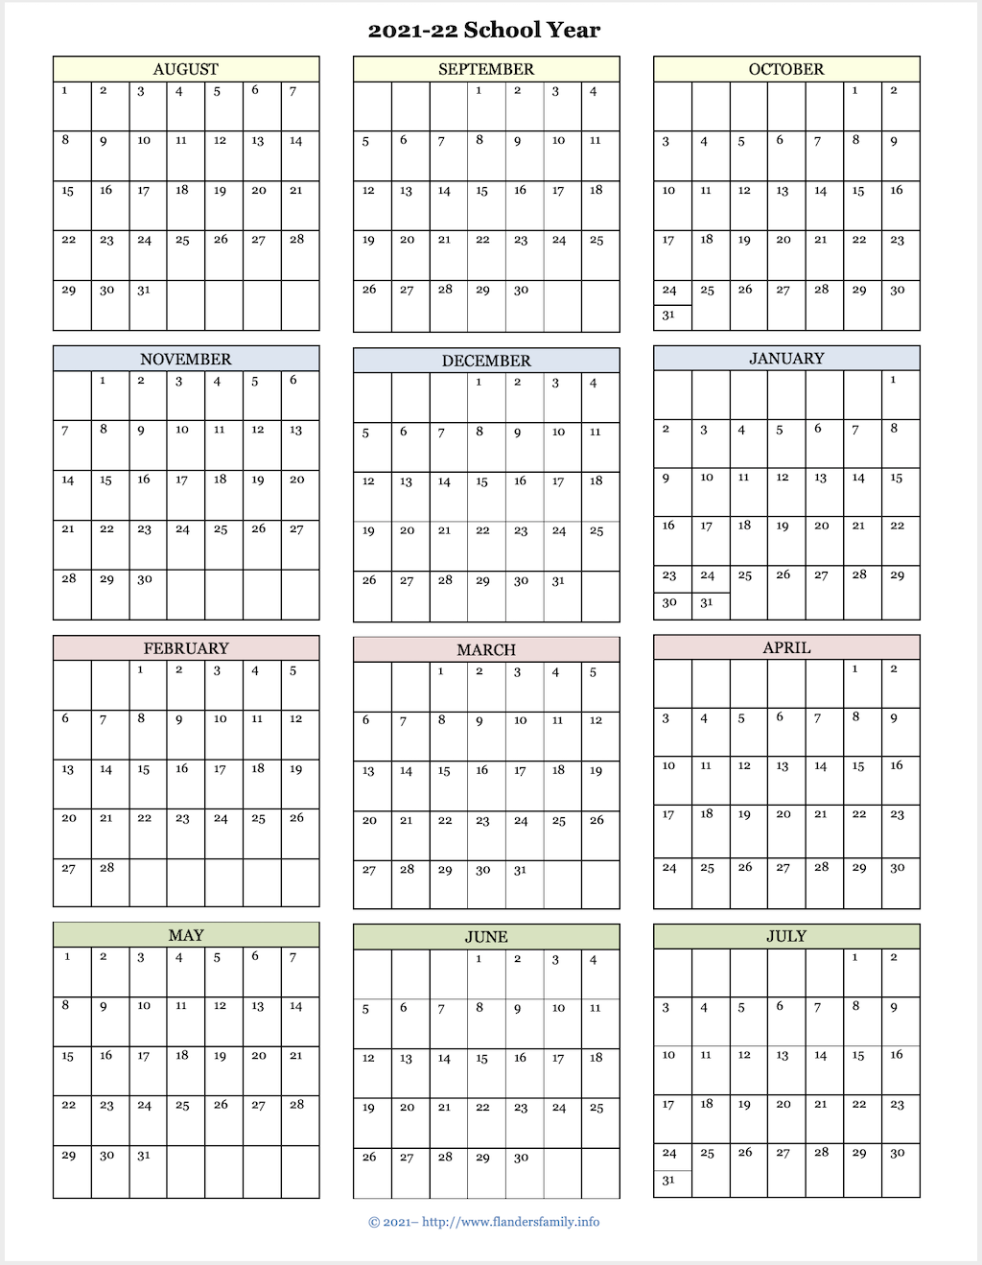

Slide 4
Key Dates
November 2nd, 4th, 8th and 10th – Maths and Numeracy GCSE exams
January 2020 – Maths and Numeracy GCSE results
January/Feb 2020 – GCSE Science practical exams
April - Welsh oral exam
15th of May – Start of the summer series of GCSE examinations.
25th of June – End of summer series of GCSE examinations.

Slide 5
The Importance of Structured Revision

Slide 6
Revision - The Statistics
66% material is forgotten after 7 days
88% material is forgotten after 6 weeks
Reading notes and text books leads to a mere 10% retention ☹

Slide 7
Revision Activities
Mind-maps
Key words – post-its
Flash Cards
Podcasts
Family and Friends Test
Highlight
Chant/Rap
Exam Questions and Mark Scheme
Write your own Q’s
Mnemonics

Slide 8
After a one hour memorising session:
10 minutes later revise the topic for 10 minutes
1 day later revise the topic for 5 minutes
1 week later revise the topic for 2-5 minutes
1 month later revise the topic for 2-5 minutes
Before exams revise the topic as required.
Each time knowledge is reinforced; it enters deeper into the long-term memory and becomes more stable.

Slide 9
Be organised/Make a timetable
Know your topics and subtopics.
Plan when you are going to study.
Use short bursts.
Timetable in exercise.
Sit at a desk – somewhere designed for study
Make task specific & realistic

Slide 10
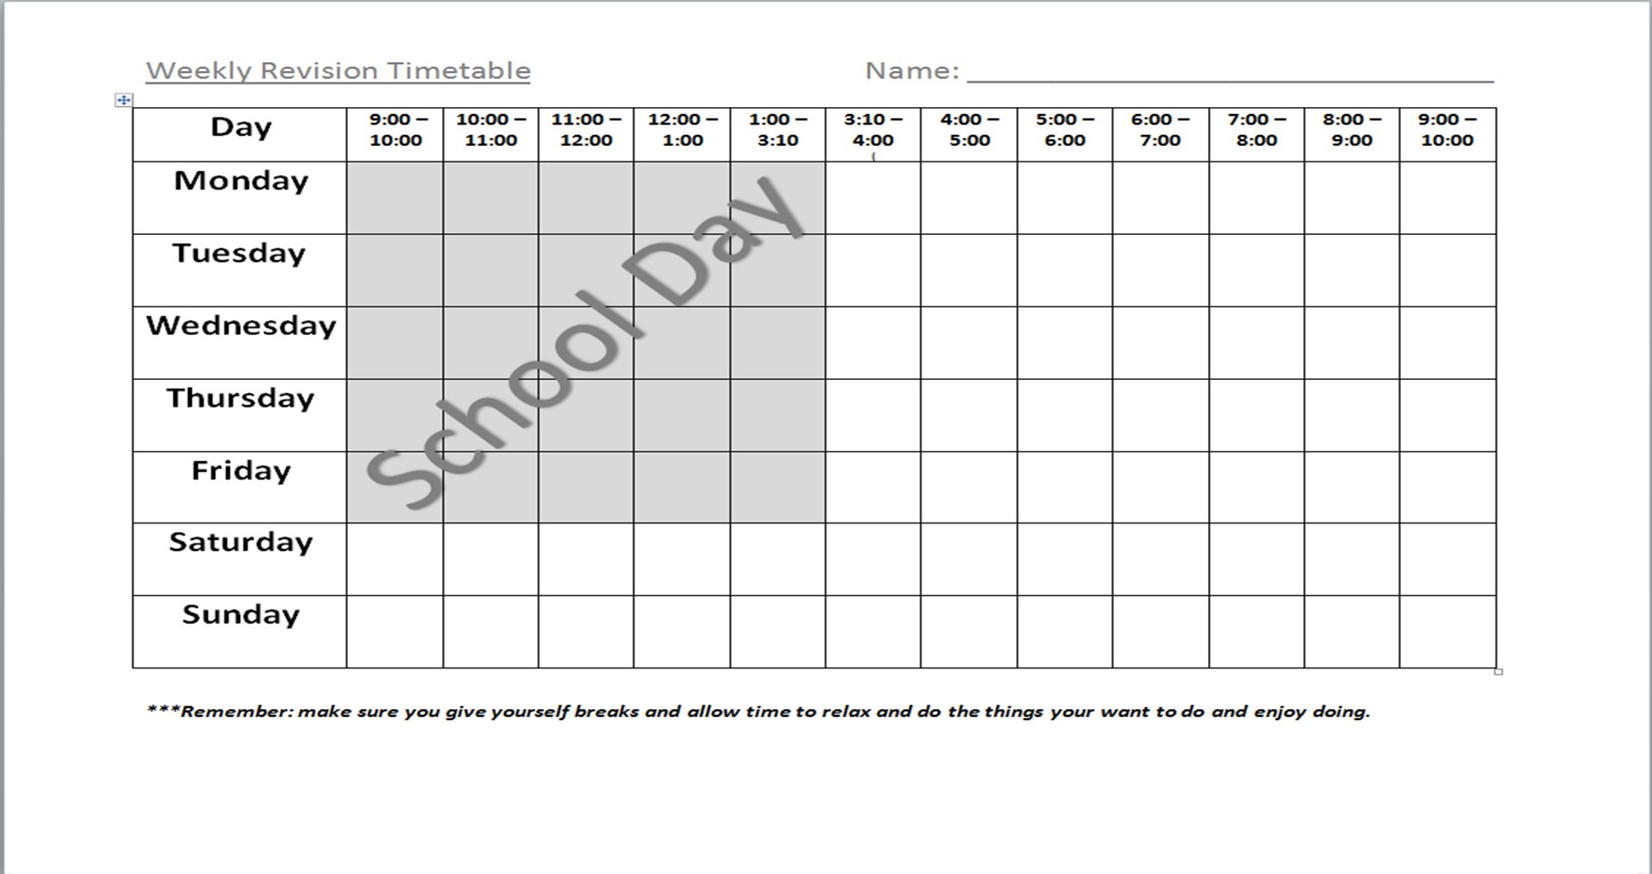

Slide 11
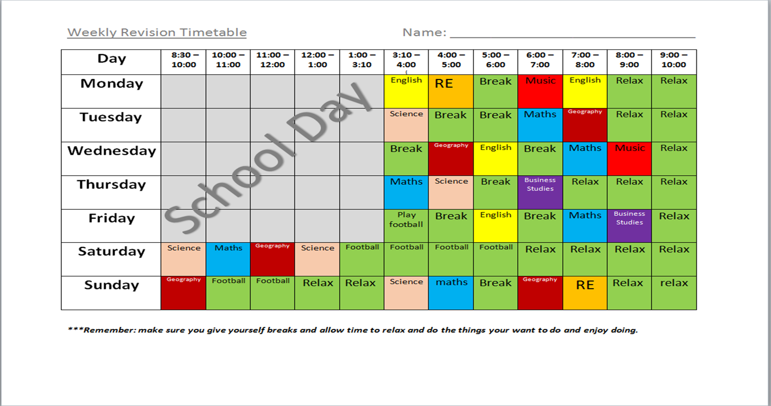

Slide 12
Core Subject Information

Slide 13
GCSE English Language
Unit 1
Individual presentation – completed by most last week (20%)
Units 2 and 3
Exams - June 2022 (40% each)

Slide 14
The Exam Papers
2 hours
2 sections
Reading (comprehension) skills
Writing skills

Slide 15
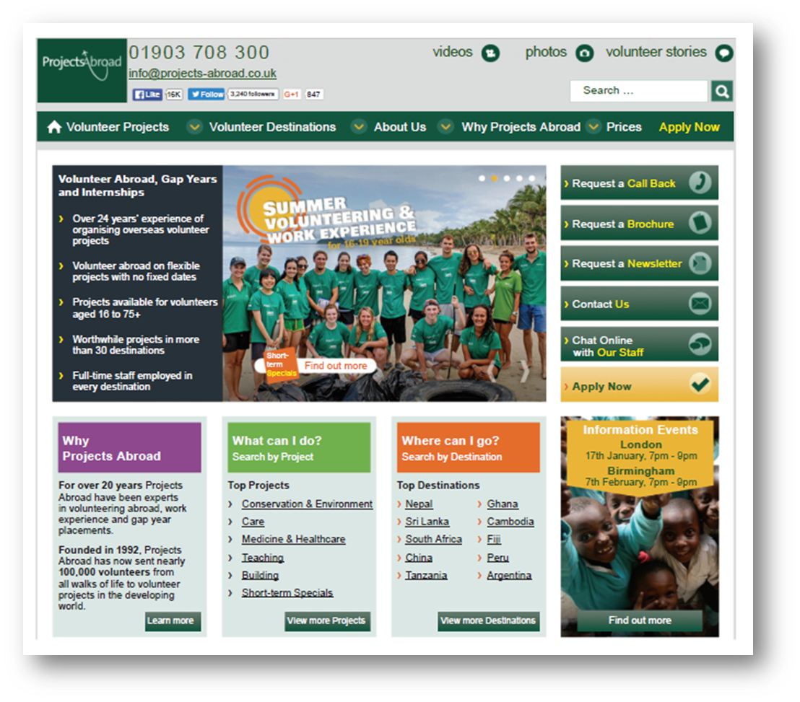
Range of texts

Slide 16
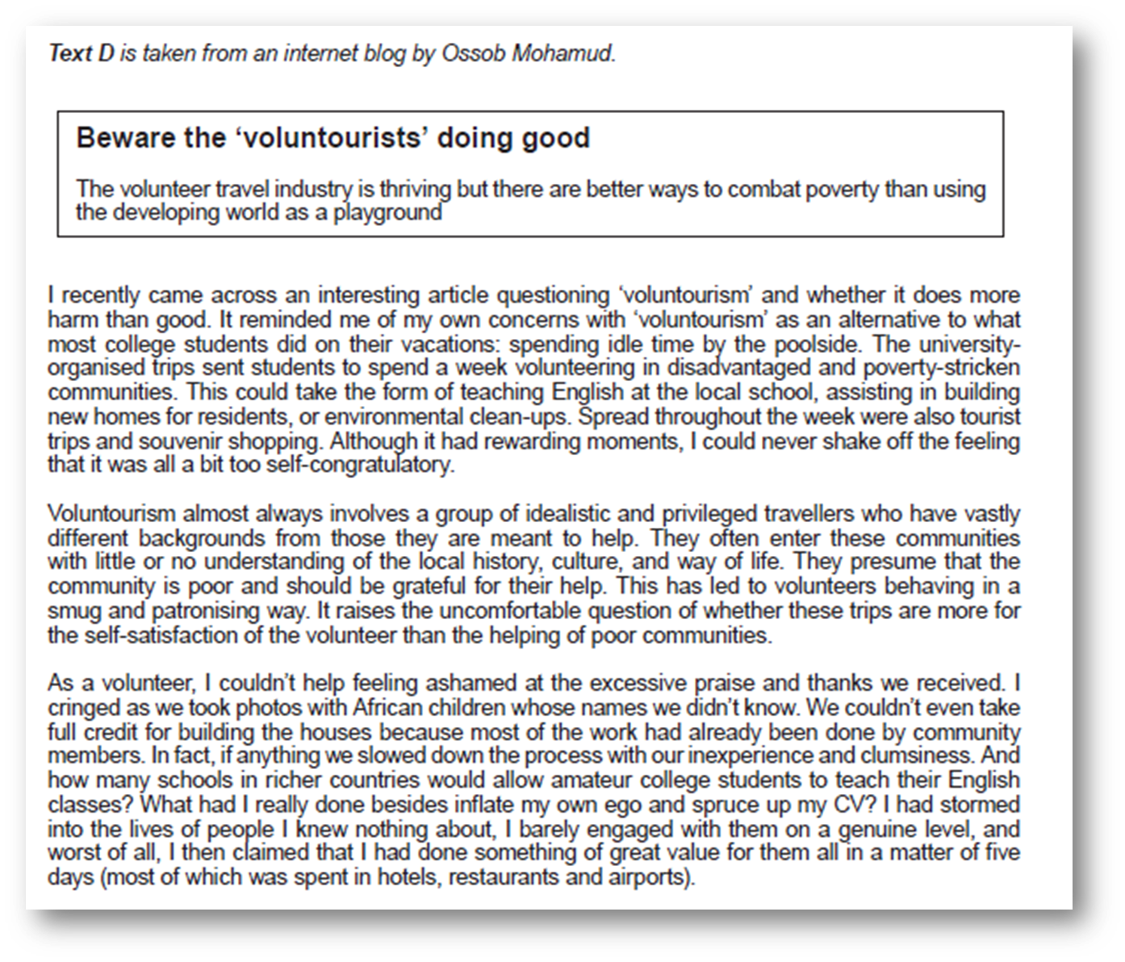

Slide 17
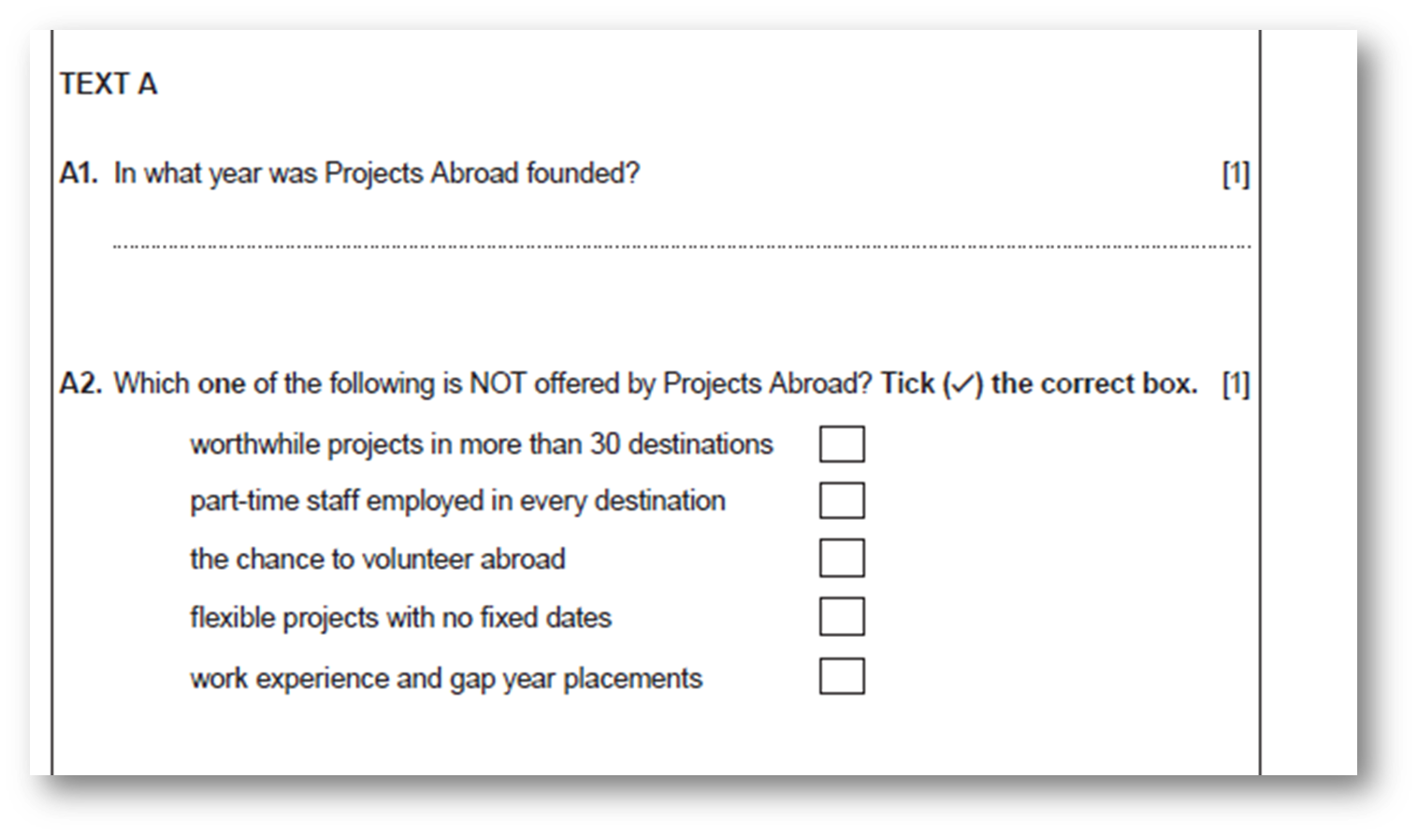
Range of question types

Slide 19
Writing long enough answers

Slide 20
Editing tasks

Slide 22
Writing tasks

Slide 23
Writing tasks - issues
Writing enough, but not too much
"Showing off"
Vocabulary
Sentence variety
SPAG accuracy

Slide 24
How can parents help?
Encourage them to read – news stories, sports reports, review, magazines, blogs, fiction
Correct them! "Should of … We was .... There is lots of..."
Contact their English teacher and ask
Buy revision guides / talk about how they're using them

Slide 25
Revision
Skills practice (CGP)
Past papers
Beware YouTube videos – out of date / wrong exam board. We will recommend.

Slide 26
978-0198408383
978-1510419933
978-1471868290

Slide 27
CGP Website Spelling, Punctuation and Grammar

Slide 28
Mathematics
Quick recap:
There are 2 GCSEs available: Mathematics and Mathematics-Numeracy
Each qualification has 3 tiers of entry: Foundation (D-G), Intermediate (B-E) and Higher (A*-C)
There are 2 exams for each qualification: Unit 1 Non-Calculator and Unit 2 Calculator, each contribute 50% towards the grade.

Slide 29
Entries
Mathematics
Exam entry for the whole year group.
Numeracy
Exam entry for 11h and 11ah
Numeracy: Entry for all classes except 11h and 11ah
(Mathematics: Resit opportunity)
Results
January
September
November
May/June

Slide 30
Exam Dates
Mathematics (full cohort)
Unit 1 Non-Calculator | 8th November
Unit 2 Calculator | 10th November
Numeracy (11h and 11ah only)
Unit 1 Non-Calculator | 2nd November
Unit 2 Calculator | 4th November

Slide 31
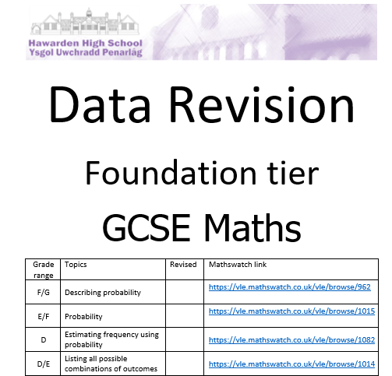
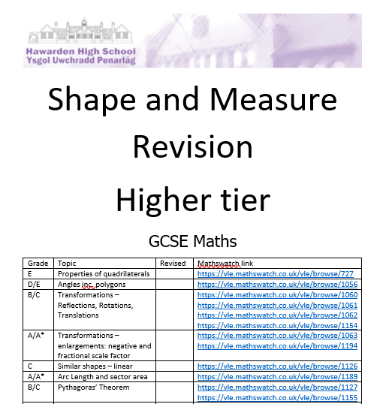
Resources
All pupils will/have received the following:
A revision list (revised following Covid adaptions)
A data booklet
A shape and measure booklet
A number booklet
An algebra booklet
These booklets are kept in a folder and contain all past paper exam questions for familiarisation and links to the mathswatch website for instructional videos

Slide 32
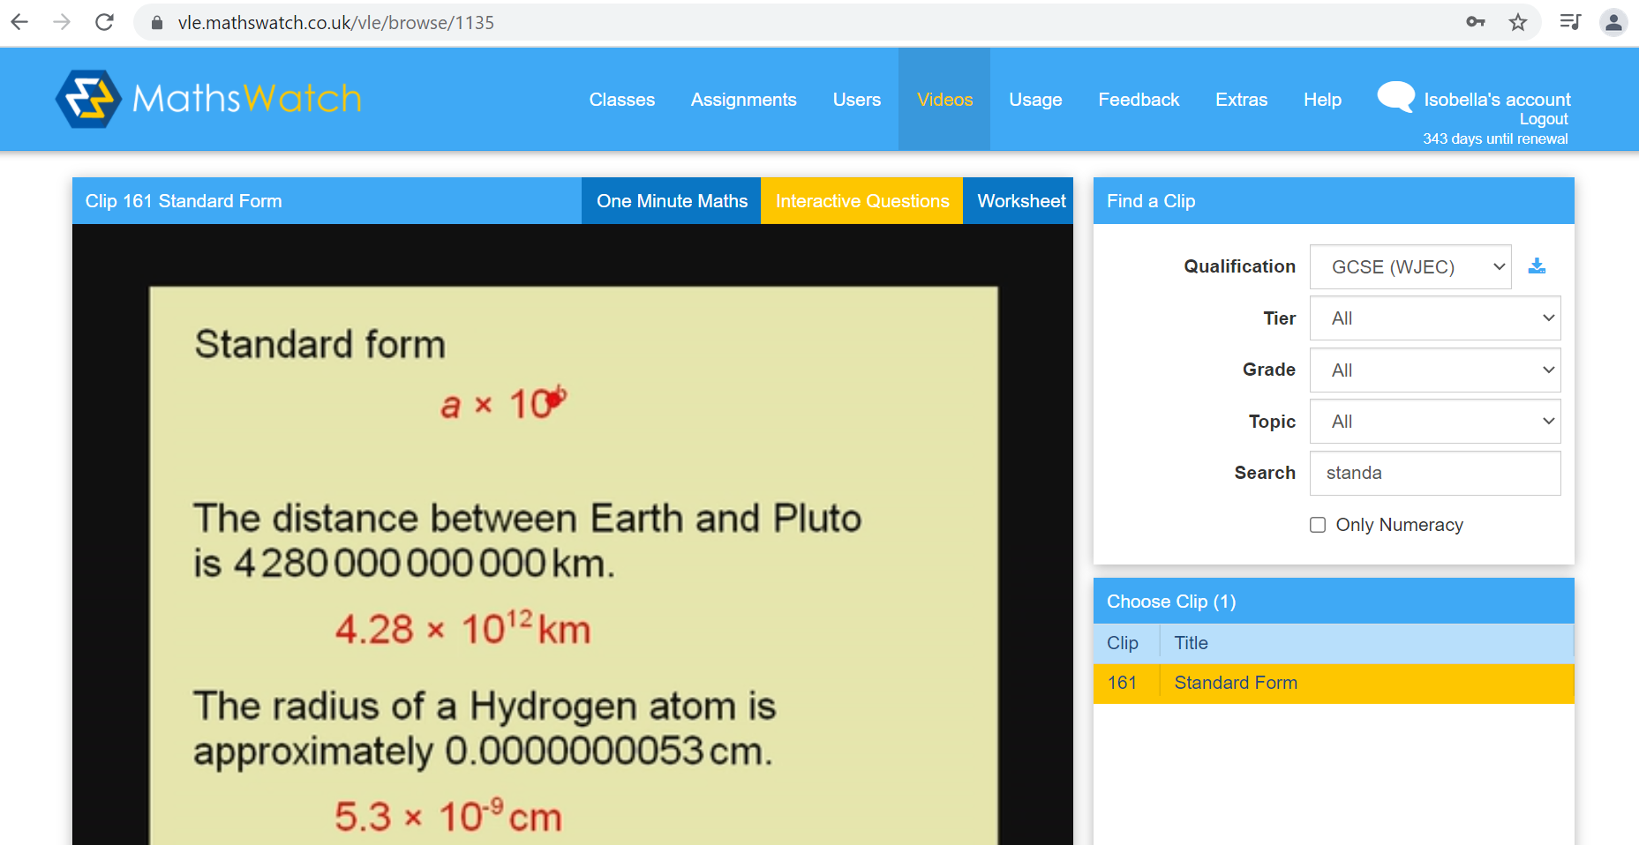
Resources
Login example:
17VBirch@hawarden
Initial of forename, then surname
Year they started high school
Everyone’s password:
hhs2020

Slide 33
After school revision
Tier | Day and Location
Higher | Wednesday— Room 18
Intermediate | Tuesday—Room 15 Wednesday / Thursday—Room 17
Foundation | Wednesday—Room 14

Slide 34
Mock paper
Thursday Unit 1
Friday Unit 2

Slide 35
Science Faculty Hawarden High School
Head of faculty – Sarah Bunn

Slide 36
Qualifications in Science
 | WJEC Triple award GCSE Biology, GCSE Chemistry, GCSE Physics | WJEC GCSE Double award science | WJEC GCSE Double award Applied science
Classes | 11A1, 11A2, 11A3 | 11B1, 11B2, 11B3, 11B4 | 11C1, 11C2
Summer written exams | Unit 2 Biology (1Hr 45mins) Unit 2 Chemistry (1Hr 45mins) Unit 2 Physics (1Hr 45mins) | Unit 4 Biology (1Hr 15mins) Unit 5 Chemistry (1Hr 15mins) Unit 6 Physics (1Hr 15mins) | Unit 3 – Food, materials and processes exam (1Hr 30mins)
Practical examinations (Attendance is crucial) | Removed by WJEC for 2022 | Removed by WJEC for 2022 | Unit 4: task based assessment 4th Jan- 18th Feb Unit 5: Practical – Removed by WJEC.

Slide 37
Tier of entry
Your child’s science teachers will be best placed to decide if they should be sitting a higher tier or foundation tier paper.
Your child can mix and match foundation and higher tier for any of the written examination units.
Students aiming for a C grade are best doing foundation tier units.

Slide 38
How can I support my child best?
Buy revision guides for their course. These are available via the school gateway app. £5 for each biology, chemistry and physics or £8 for double award science. Our science technician will deliver them to your child in their science lesson.

Slide 39
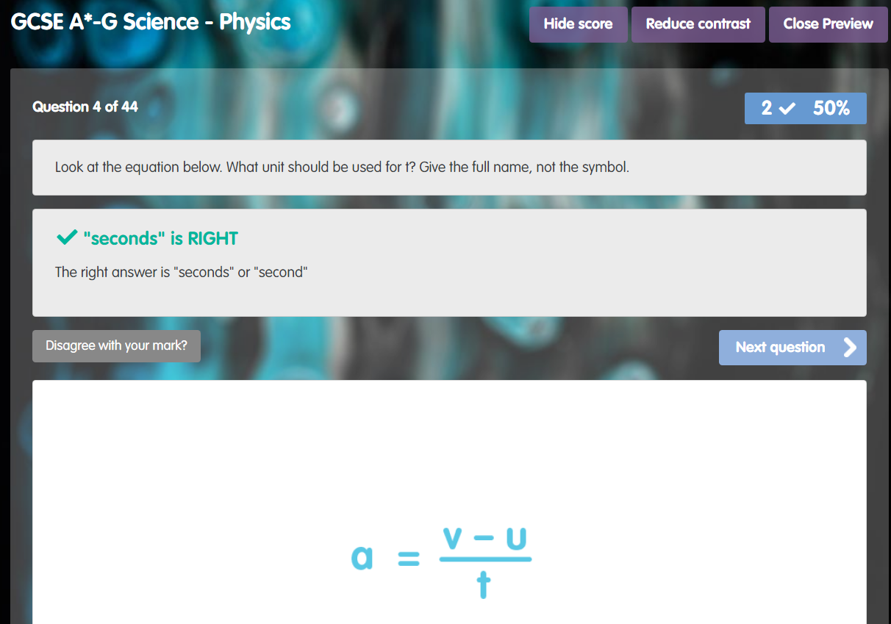
Encourage them to use the Educake.co.uk for knowledge test questions

Slide 40
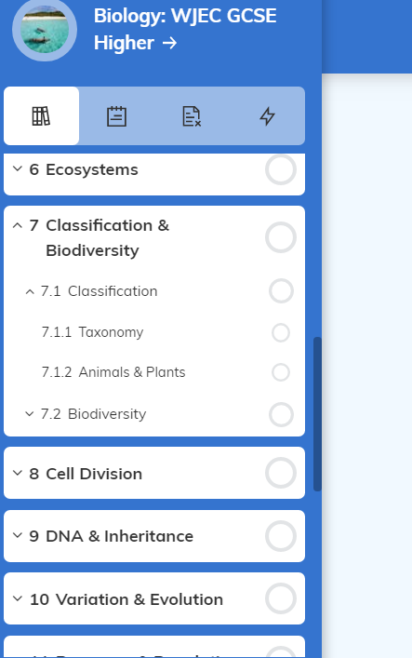
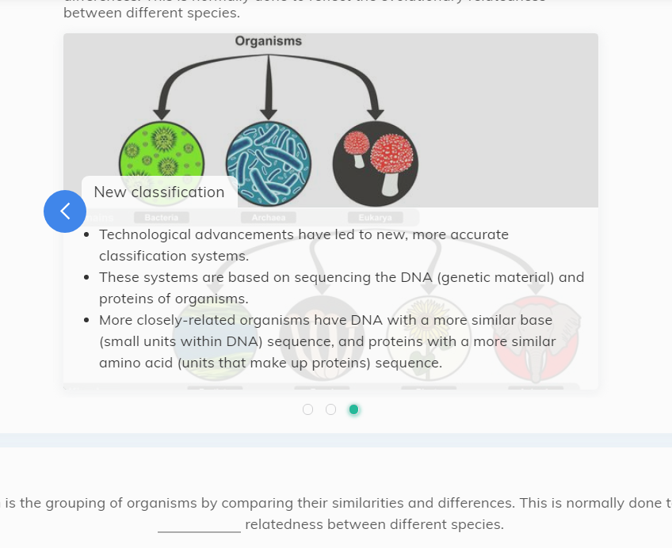
Encourage them to use the Senecalearning.com for summaries and questions

Slide 41
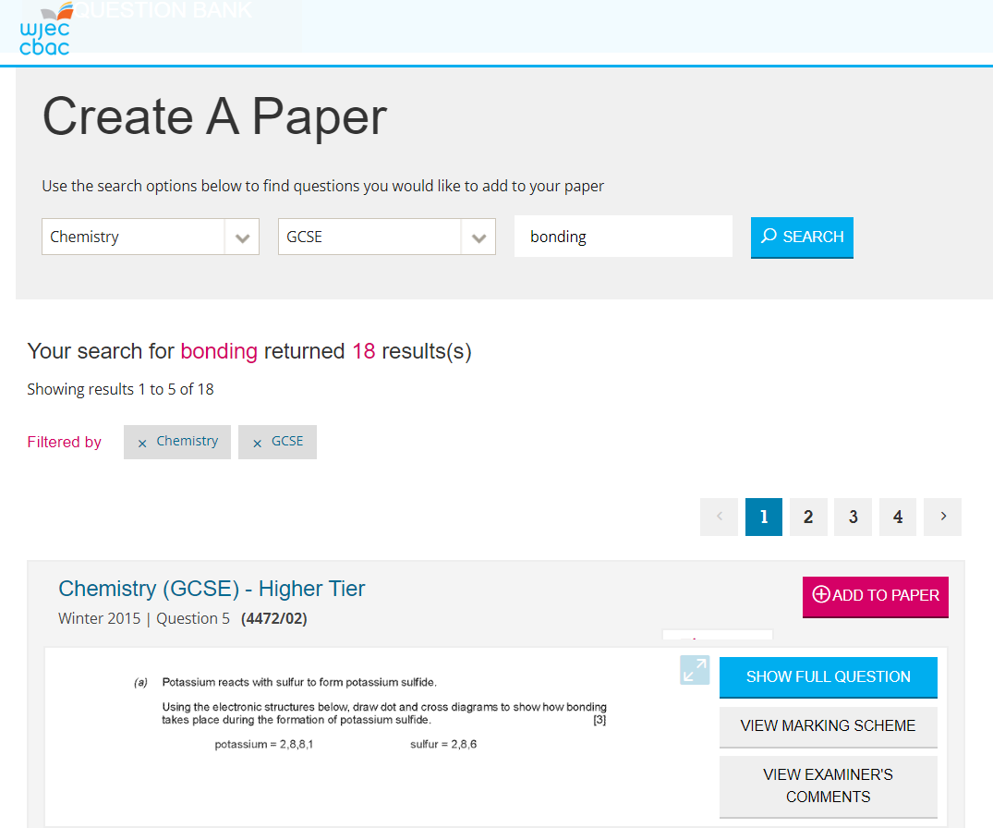
WJEC question bank for past paper questions and mark schemes.

Slide 42
WJEC knowledge organisers

Slide 43
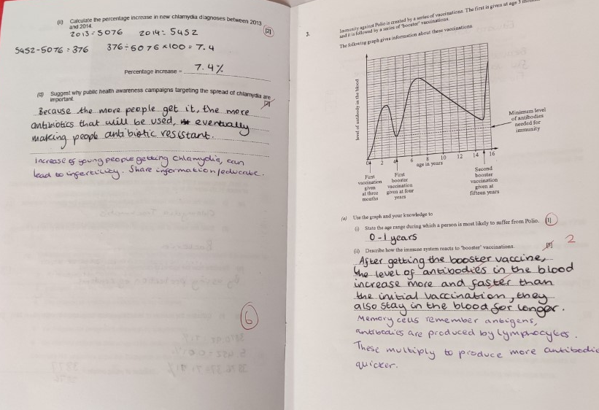
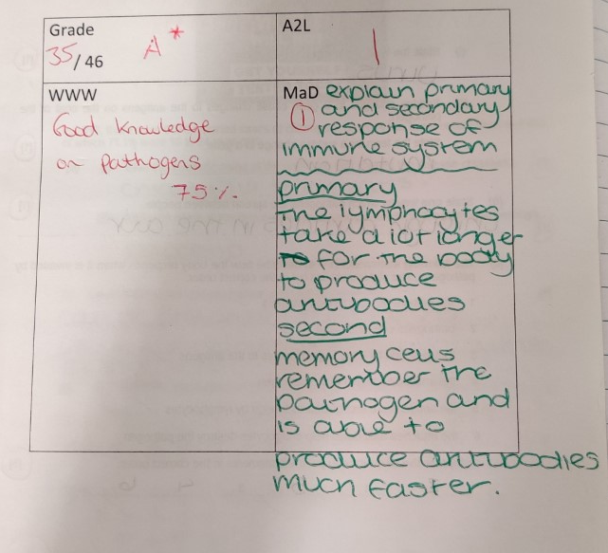
Exercise books

Slide 44
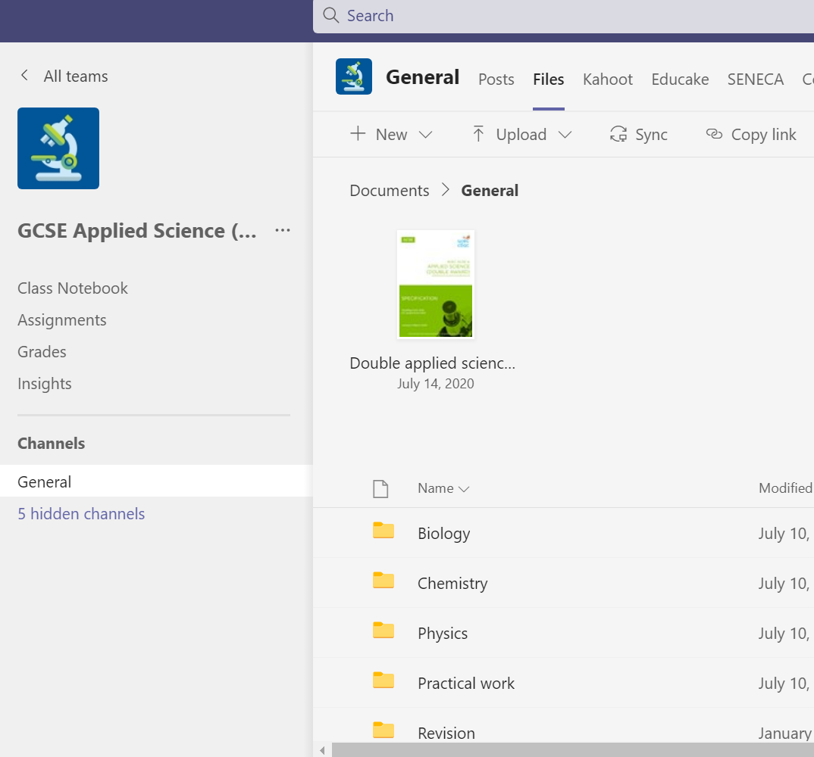
Microsoft Teams

